Slide 1

Cloudgineers
Jackson Gray
Carnell Greenfield
Jaden Jefferson
Nick Miller
Kelly Payne

Slide 2
Summary
Method: Use OpenStack to set up a private cloud
Process: Install and configure software
Goal: Create a private cloud

Slide 3
OpenStack
OpenStack
Set of open-source cloud computing software components
Which manage
Compute Resources
Storage
Orchestration
And many more cloud computing services.

Slide 4
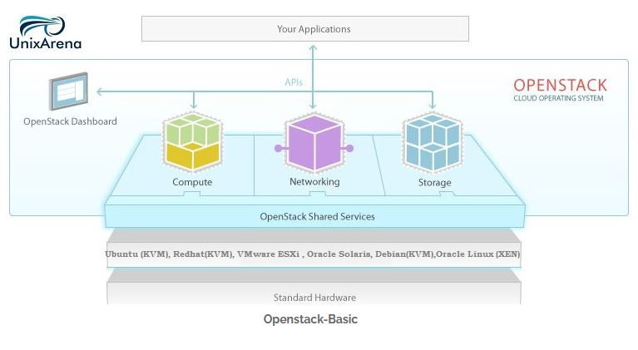
Basic Architecture

Slide 5
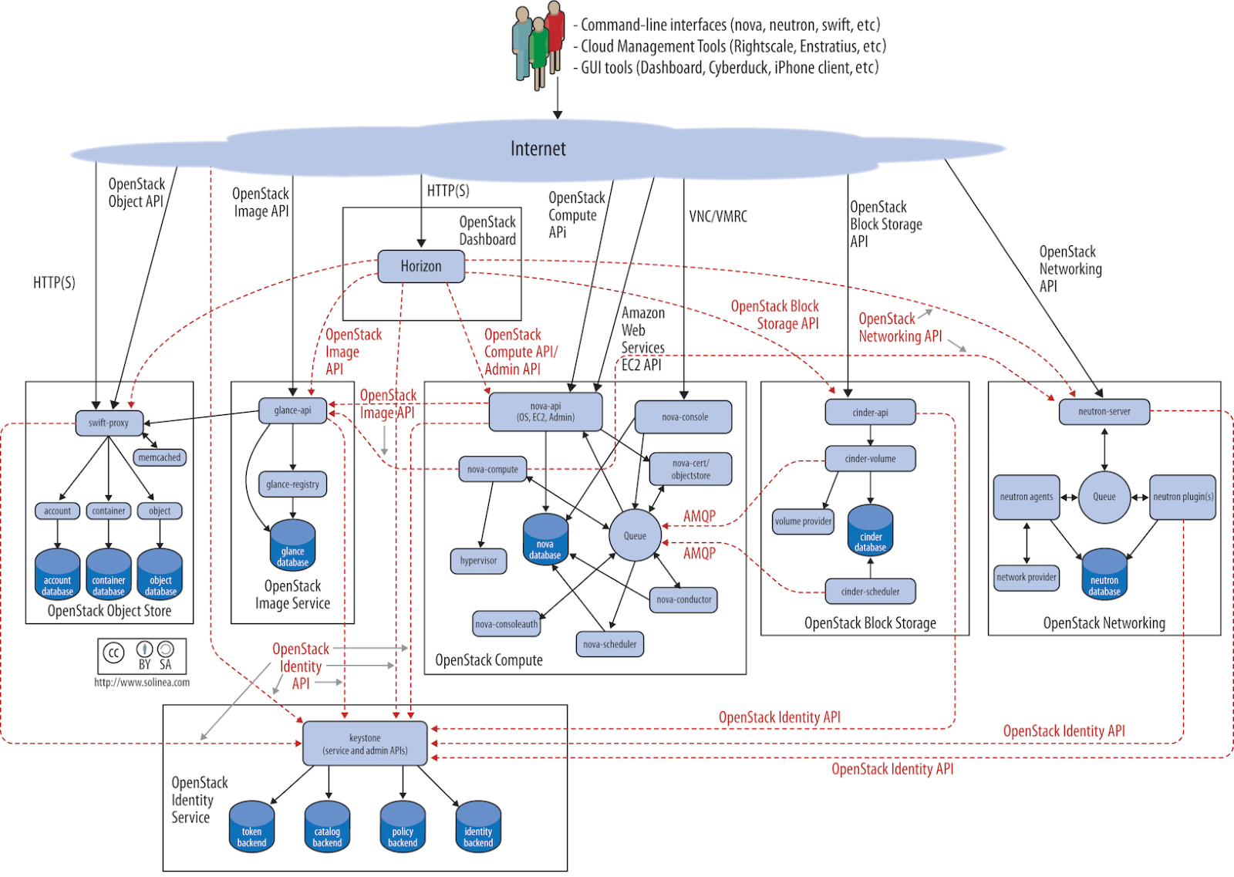
Complete OpenStack Architecture Model

Slide 6
Epics Worked on Since Last Meeting (Still In Cycle 2)
Linux Operating System
Dell Remote Access Controller
Server Network
Rack Cabinet
OpenStack Playground

Slide 7
Future Epics Being Pulled In For Cycle 3
ALL previous features
Continue OpenStack Playground
Deploy basic OpenStack production environment
User Dashboard - Horizon
Identity Access Management - Keystone
Networking Service - Neutron
Compute Service - Nova
Block Storage Service - Cinder

Slide 8
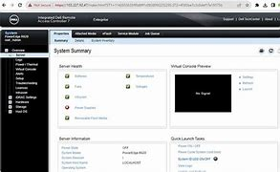
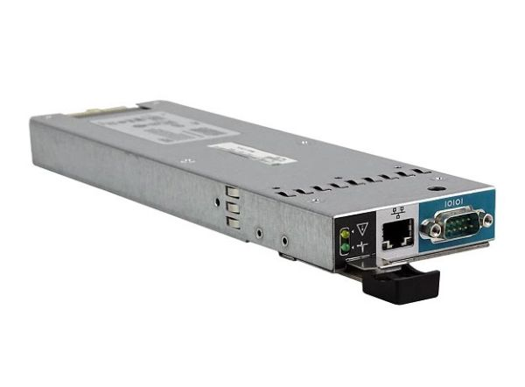
Dell Remote Access Controller
✅ | Installation & Walkthrough
✅ | RAID Configuration (Reassessment)
 | IDRAC Server Profile
 | Hardware Monitoring
 | Virtual Media

Slide 9
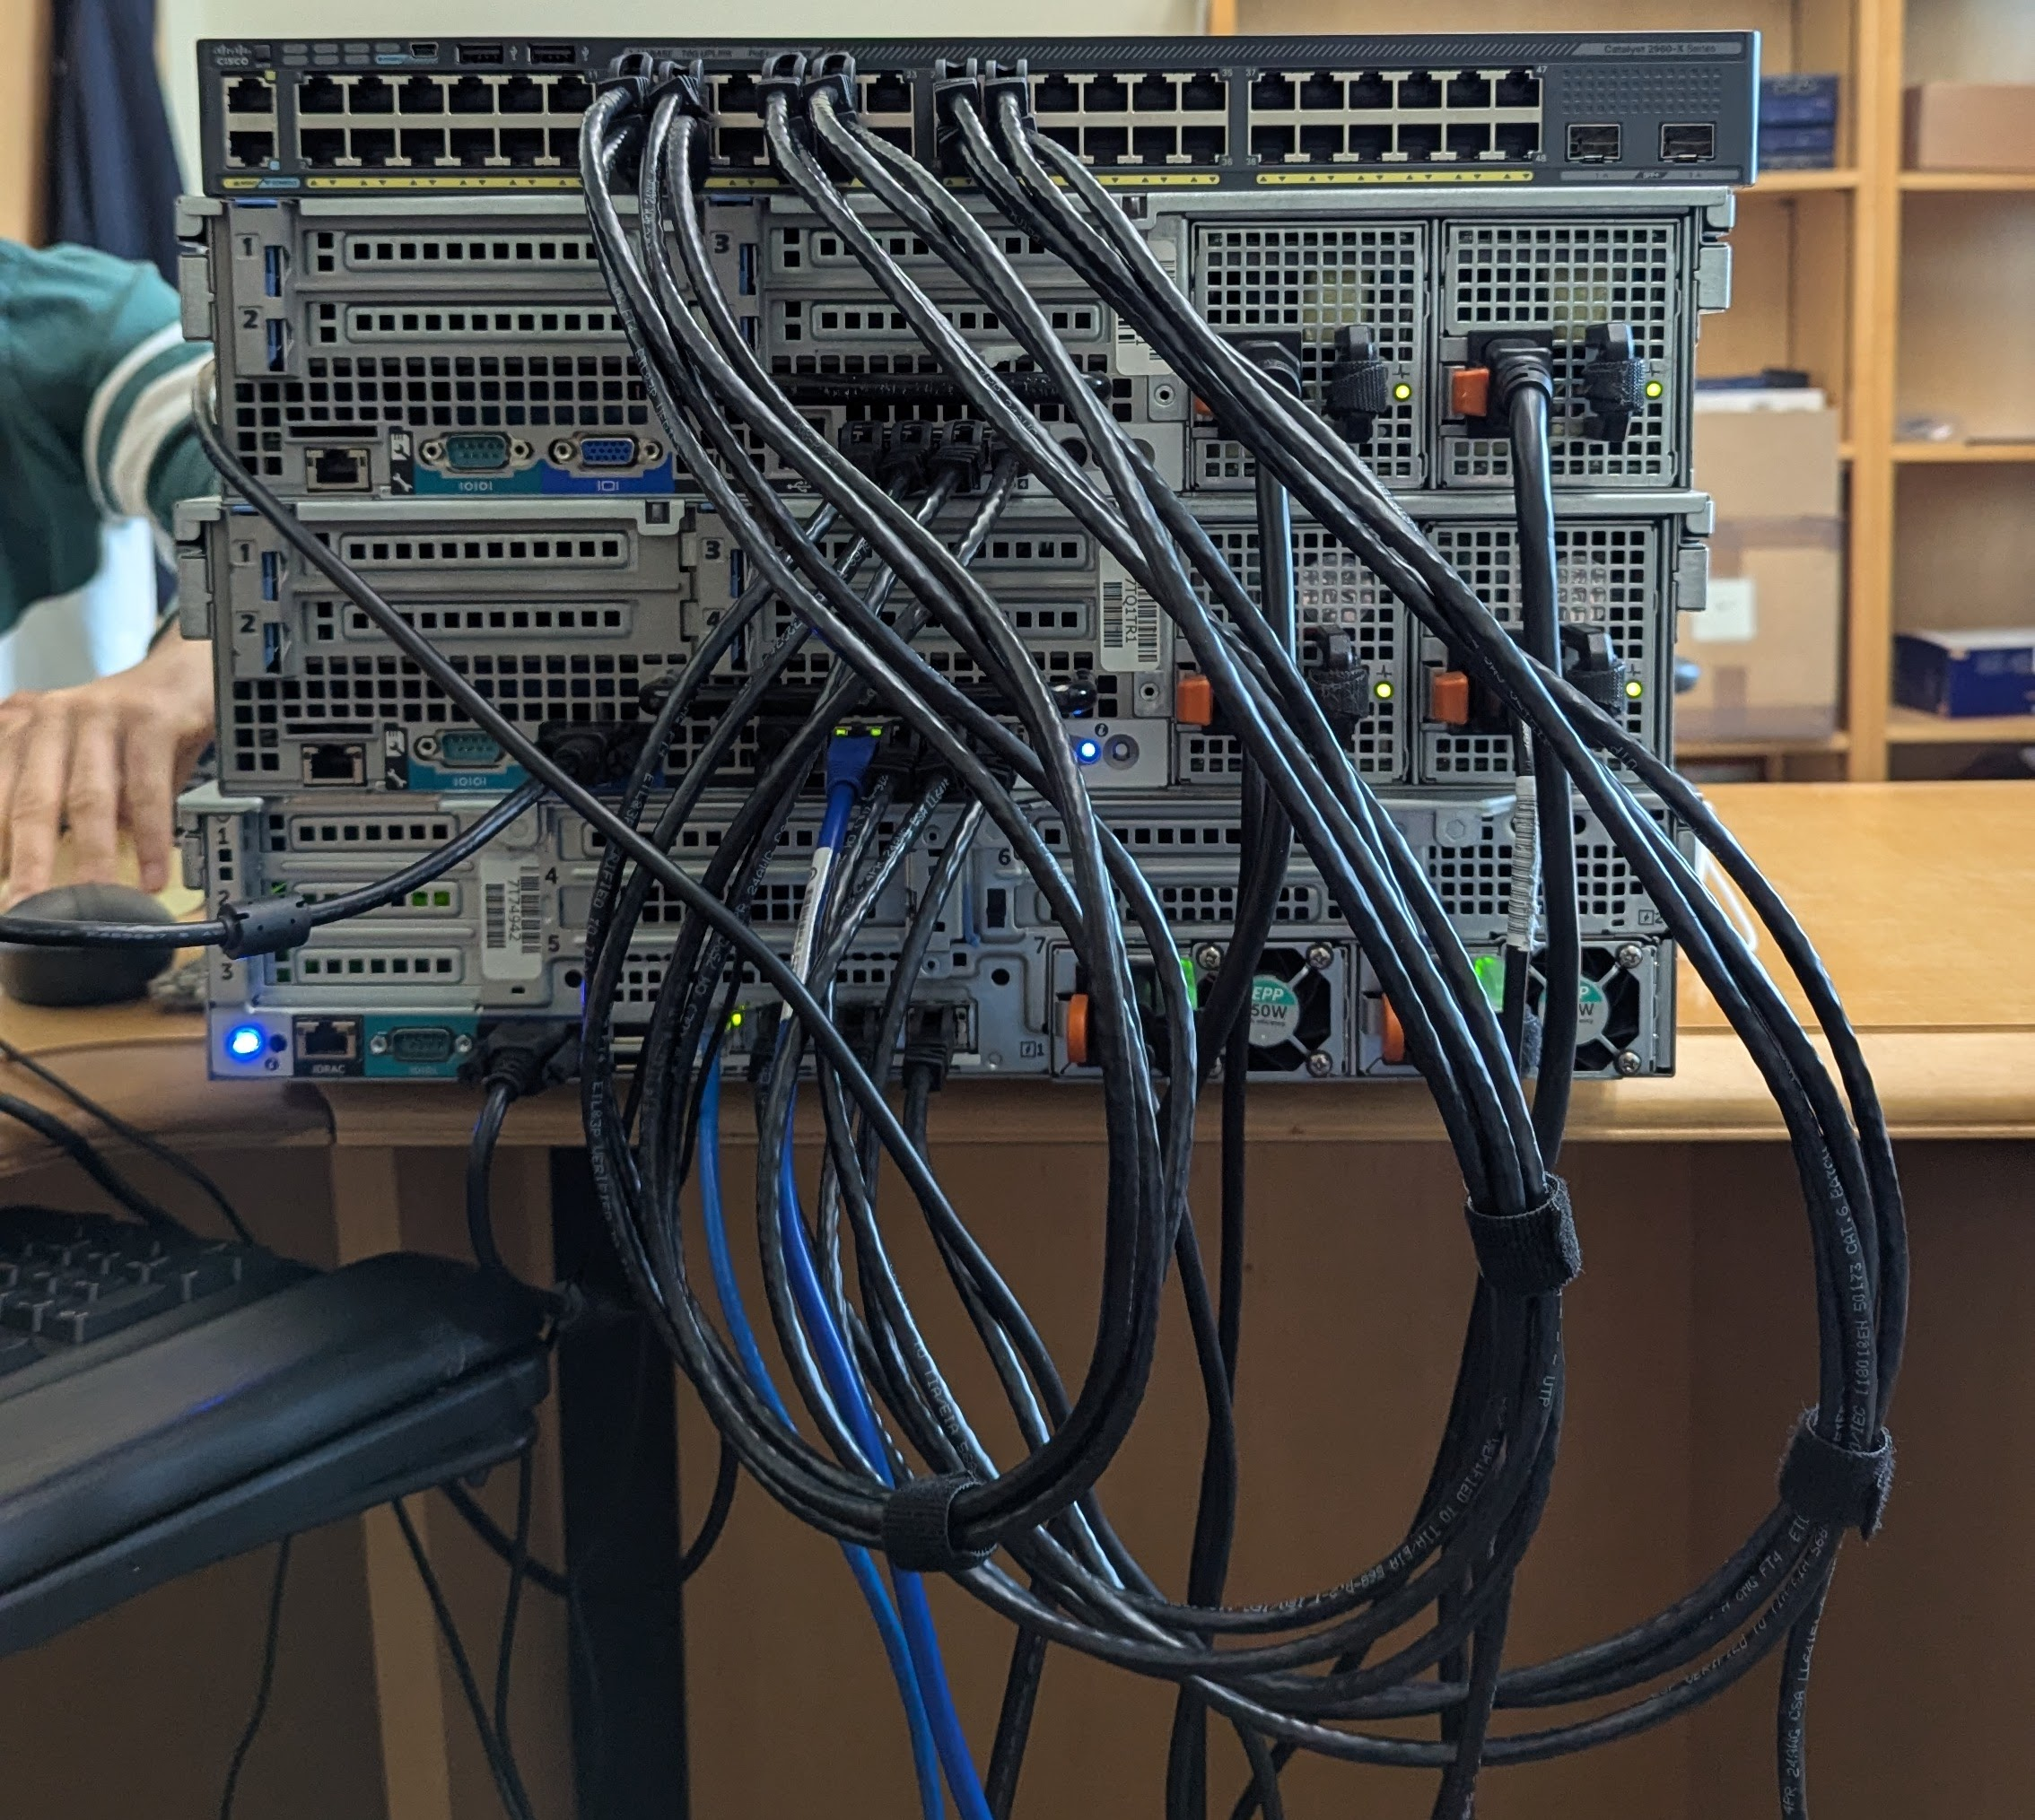
Server Network
✅ | Get IP Address Configured
✅ | Get Switch Up and Running
✅ | VLAN Configurations
✅ | Internet Access through Wall Port
✅ | Connect Servers to VLAN

Slide 10
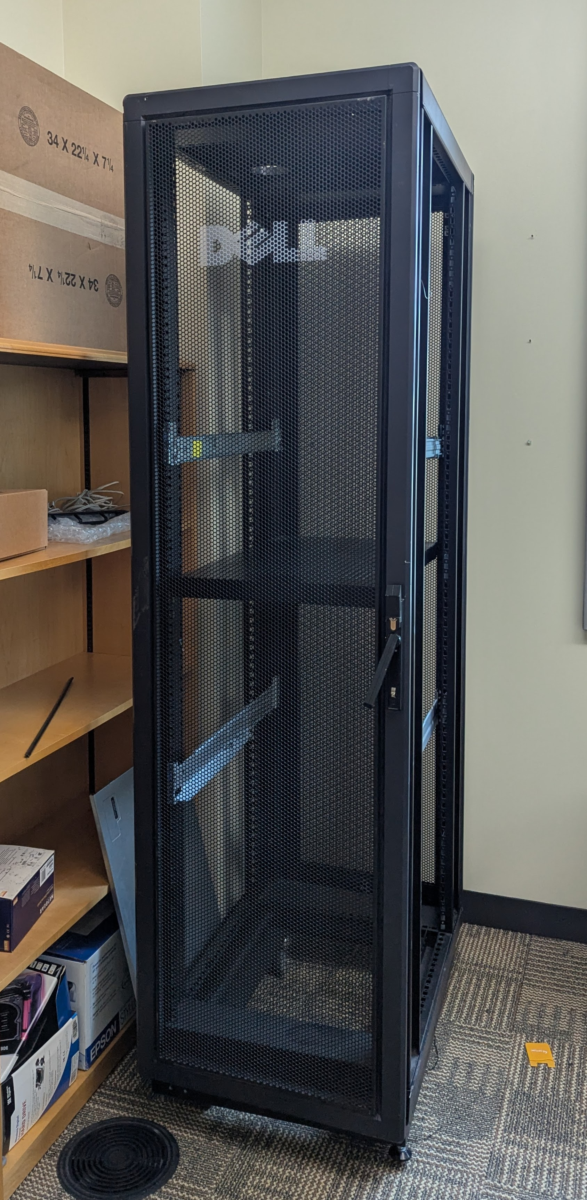
Server Room Setup: Rack Cabinet
✅ | Access Point to Enter Cabinet
⏳ | Stabilize Roll-out Trays
 | Insert Dell Servers
 | Insert Cisco Switch

Slide 11

OpenStack Playground
Deployment of a basic OpenStack environment for testing and development.
⏳ | Proof of Concept: DevStack
✅ | Single Node Deployment
 | Lab Creation

Slide 12

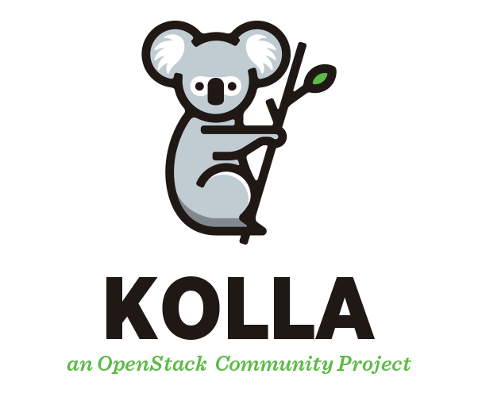
Base OpenStack Deployment
Currently waiting on wall port access
Switch has been blacklisted from network
Hands are tied by UITS
Kolla-Ansible

Slide 13
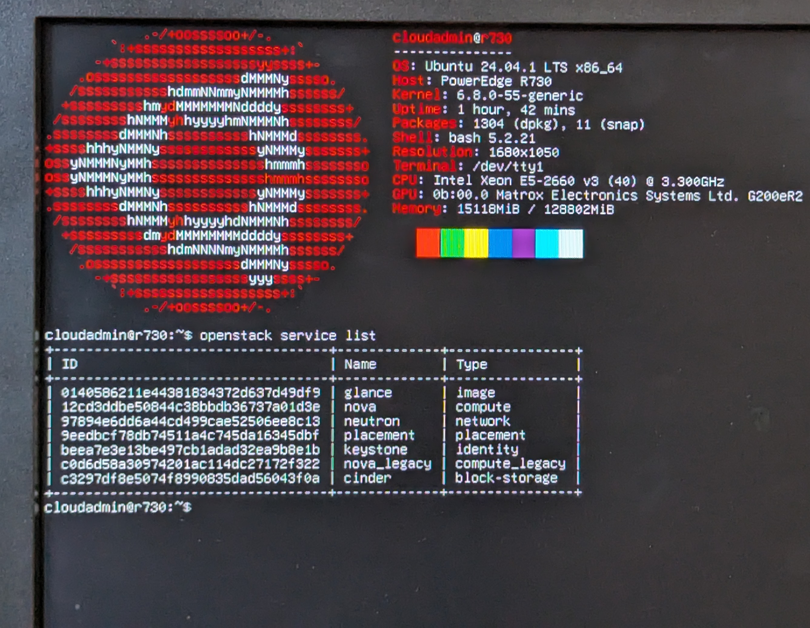
Devstack Services

Slide 14
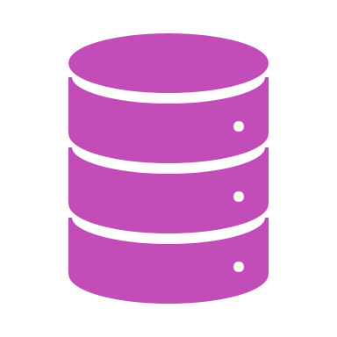
Other Epics
OpenStack Components
Continuous Learning
Continuous Improvements

Slide 15
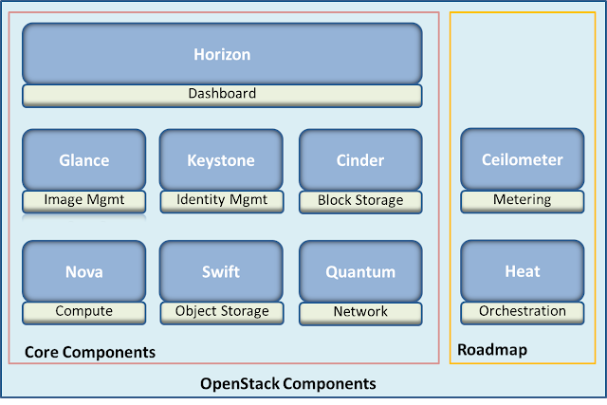
Features
User Dashboard
Identity Management
Networking Service
Computing Service
Imaging Service
Block Storage Service
Object Storage Service
Neutron

Slide 16

Continuous Learning
Our continuous learning has included research on:
OpenStack
DevStack
Kolla-Ansible
Kubernetes
Cisco Switches
Linux & Ubuntu Server

Slide 17

Continuous Improvements
Hardware Requests
Extra RAM, CPU power, file storage

Slide 18

What did we learn?
Basic DevStack installation
Basics of interacting with an Opens
How to tackle bugs facing common issues in DevStack
Using the Linux command line
Installing rails in the server rack
RAID levels
LUKS encryption through Ubuntu installation wizard

Slide 19
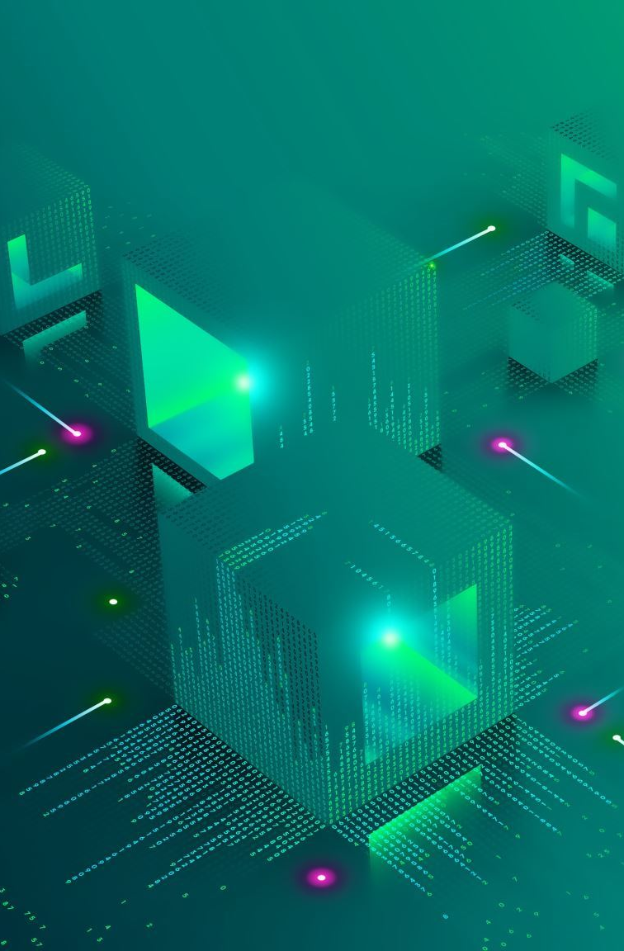
Conclusions
Using DevStack, we initialized OpenStack on server R730 as a single node deployment.
Our plans are to use the desktop for DevStack installation so we can separate DevStack and OpenStack.
The R710A will be the controller, the R710B will be used as the network, and the R730 will be used for compute and storage.

Slide 20
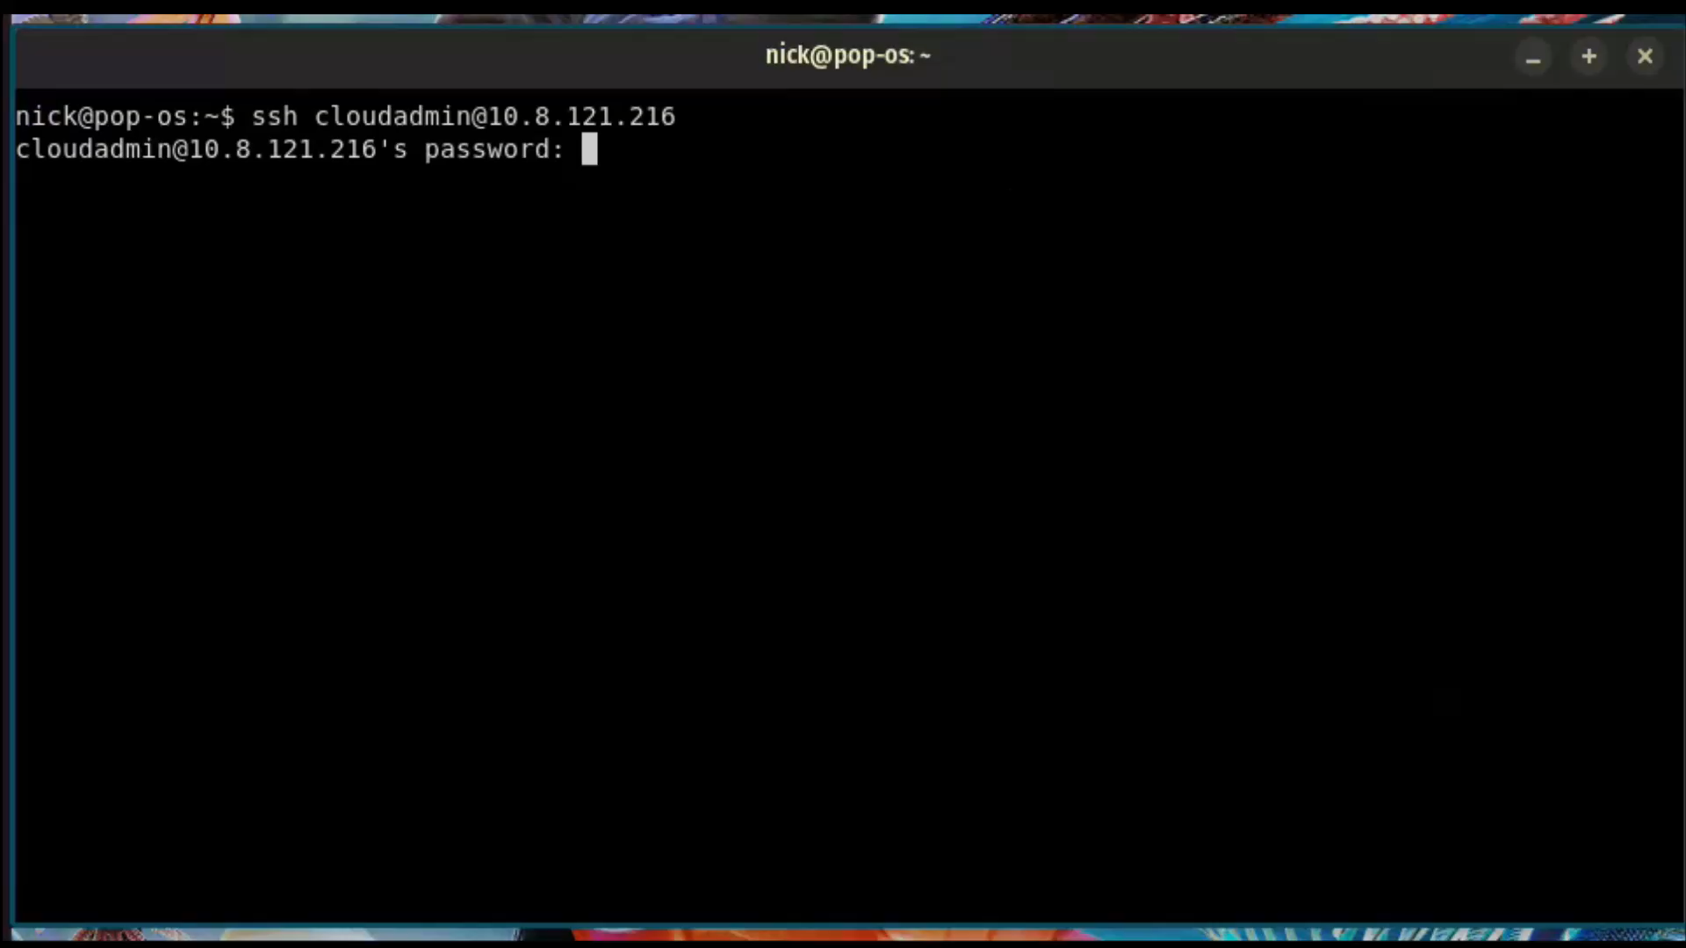
Demo Video
Video File

Slide 21

Q & A

